Slide 1
Scotiabank HackIt Debt Challenge

Slide 2
Event Details
February 5-7, 2016
40 hr hackathon
Scotiabank HackIt Workshop:
Wednesday January 27 2016 6:00 PM - 9:00 PM
Steelcase, 200 King Street West, Suite 2400, Toronto, ON, Canada
Also transcript will be available for those who can’t make it
SIGN-UP IS REQUIRED - https://www.picatic.com/HackITWorkshop

Slide 3
Discuss Availability
Meet-ups
At least one every weekend
Possible sub-group meet-ups
One-on-Ones (For team leads)
Workshop availability
Competition Availability
Who can stay 24hr at the competition
Also Timmy will do food runs

Slide 4
The Business Analysis
The aim of this Hackathon vaguely revolves around managing debt
Asset Liability Calculator
Liquidation (Appraisals for Mortgage)
Interest Rate watcher
There are many other financial problems to tackle. Some may involve market trading, capital management or currency exchange

Slide 5
5 Minute Idea Generating
Try to think of a few high-level sketched-ideas of applications that may be useful towards people’s financial lives
Types of Financial Services
Banking – deposit, withdraw, interest
Insurance – money returns on events
Stock Market – Business investments
Treasury or Debt instruments – government investments
Wealth Management – Investment on assets
Mutual Funds – Investment on collectables
Tax / audit firm – Asset/Liability management

Slide 6
Software And Development
The design of software will be important. We will most likely need to be a full stack team.
Full Stack Layers:
Server, Network, and Hosting Environment
Data Modeling
Business Logic
API layer / Action Layer / MVC
User Interface
User Experience*

Slide 7
Full Stack Development Applications
LAMP (Linux ⬄ Apache ⬄ MySQL ⬄ Perl/PHP) stack
WISA stack (Windows ⬄ IIS ⬄ SQL Server ⬄ ASP.NET)
Java web application stack (Linux or Solaris ⬄ Tomcat ⬄ MySQL ⬄ JSP)
Javascript Web Application stack (MySQL ⬄ Node.js ⬄ CSS/HTML ⬄ JSON)

Slide 8
Defined Roles
Team Coordinator
Manages team members and coordinates product enhancements
works with team as a bridge between business and engineering communication
Business Model and Architecture Design
Designs the business application
Defines a problem that could be solved using the application
Presentation and Documentation
Presents and documents the entire development cycle
Entrepreneur’s product to judges

Slide 9
Defined Roles (Cont’d)
Backend Model and Algorithm Design
Design of the backend processing for the application
Core development team needed to develop features requested by product manager
Manages and constructs an optimal database schema
Design Team
Designs the layout of the application
Uses user interface designs to create an easy communication between user and system
Front-end application, also the face of the team

Slide 10
Team Skills (Tentative)
Timmy:
Business Analyst
Idea Generator
Entrepreneurship
Benjamin:
Full Stack Development
Business Analyst
Business to Development
Daniel:
Stock Market Intelligence and Application
Anti-debt Solutions
Jorden:
Front End Development
Quality Assurance
Jason:
Front End Development
GUI Designer
Allen:
Full Stack Development
DBA Administrator
Nanson:
Back End Developer
DBA Administrator
Leo:
Back End Developer
Writer, development Polisher

Slide 11
My Proposed Team setup
Presentation/Documentation:
Timmy (Lead)
Leo
Team Coordination:
Timmy
Benjamin
Business Model/Design Architecture Team:
Timmy (Lead)
Daniel
Backend/Algo Dev Team:
Allen (Lead)
Benjamin (Floater)
Nanson
Leo
Design(CSS) Dev Team:
Jason (Lead)
Jorden

Slide 12
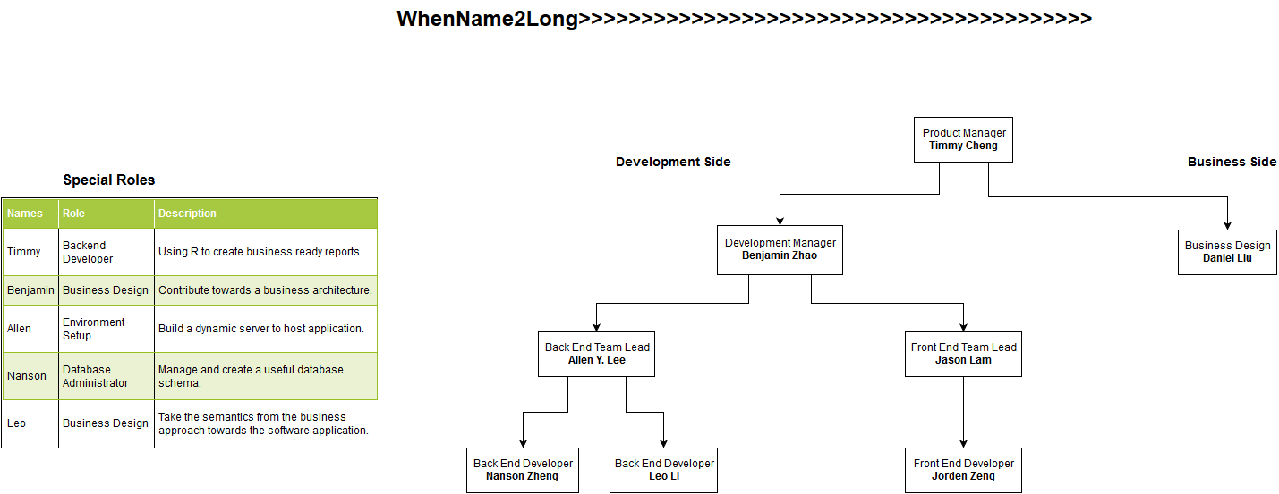

Slide 13
Agile Software Development
Agile development is a methodology of developing software by rapidly evolving solutions between cross-functioning teams
We will be following the Scrum methodology when working on our project:
Each team will have their own scrum session
Development should be based on time, not completion
At the end of each sprint we will merge each team’s progress into one application
Ensure to assign tasks that can be finished within the time constraint. In which case, we should collectively choose a good sprint length

Slide 14
Scrum Methodology
Scrum consists of three roles:
Product Owner ➔ Requests business enhancements
The product owner decides what business enhancements should be added to the application.
Scrum Master ➔ Business Translator, sprint manager, team co-ordinator
The scrum master should be able to translate the requests of the business into small tasks the team can complete. You should be aware of your team’s skills to optimally manage efficiency.
Team ➔ The developers
The development team designs and creates the software architecture to be created.

Slide 15
Scrum Methodology (cont’d)
Introduction to Scrum
http://scrumtrainingseries.com/Intro_to_Scrum/Intro_to_Scrum.htm
Practicing Scrum is a strict and rigorous process involving sprint planning, backlog refinement, daily stand-ups and sprint reviews
The product backlog is a list of tasks given by the product manager
Each sprint is a specified time-length a team has to complete its assigned tasks in the backlog
Stand-ups are short meetings that discuss each team member’s previous work, impediments, and what they are going to do

Slide 16
Scrum Methodology (cont’d)
As a team of 8, it is important to develop a scrum-like practice for the 40hr hackathon.
We should designate someone to keep track of tasks, and manage sprints
Each team leader should be responsible for each team’s stand-ups and reporting completion to the sprint manager

Slide 17
Javascript Web application Stack
Note that we will most likely be following this application stack to build our product
Languages
Java
Javascript
HTML
CSS
NoSQL, Oracle SQL, MySQL
Tools
Node.js
Bootstrap
Oracle, MongoDB, Cassandra
Sublime Text, Linux, Notepad++

Slide 18
JavaScript
Lightweight, interpreted programming language
Complimentary with Java, implemented with HTML
<html>
<body>
<script language="javascript" type="text/javascript">
<!–
document.write("Hello World!")
//-->
</script>
</body>
</html>

Slide 19
Lambda Calculus
Formal system of logic for expressing computation by way of variable binding and substitution
Notation: λx.x
Func(x) { return x }
By definition, λx.(λy.x) == λxy.x
Func(x) { return Func(y) { return x }}

Slide 20
Javascript Closures
https://developer.mozilla.org/en-US/docs/Web/JavaScript/Closures#Closure
One of Javascript’s greatest features
Used to implement public and private object properties

Slide 21
Node.js Demo
Basic Node.js Code
Implement the Hello World! Code
Host and connect to a server locally and online
Connect to a database
Request and Input data
Add a Logo!

